Slide 1
Capstone Project
Play Store App Analysis- EDA
by
Kundan Lal
Abhijeet Kulkarni
Pankaj Ganjare
Palagiri Sushma
Prudhvi Gowroju

Slide 2
Points for discussion:
Introduction
Category wise play store apps installs
Category wise most popular apps
Top 10 apps in play store considering all the parameters
Average installs, category wise
Most installed apps in communication category
Average sizes of apps in each category
Category wise percentage of paid apps
Category wise top installed paid apps
Average rating rating of paid apps
Correlation between Rating ,Installs and Price
Category wise installed apps with content rating
Top 30 Genres
Percentage reviews sentiment distribution

Slide 3
Introduction:
Play store and user reviews dataset contains details of different applications and reviews from different users.
Our intention is to analyse the data and draw some insights through Python (Pandas) chart analysis , which can prove very beneficial to any Android app development company ,to understand what market demands and what kind or category/genre of apps they can go for as there product .

Slide 4
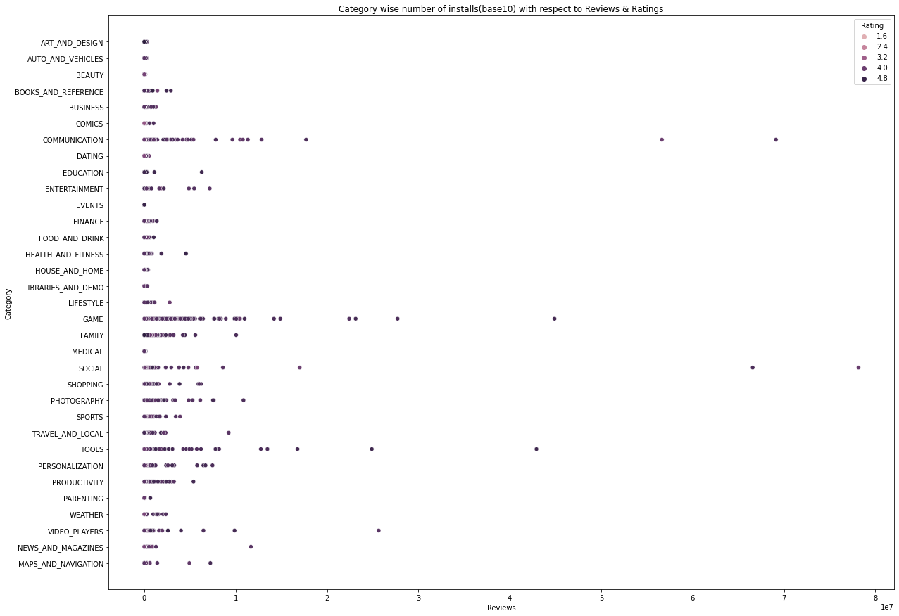
Category Wise Play Store Apps Installs

Slide 5
Category Wise Play Store Apps Installs
Findings : There are more reviews and ratings for a growing number of apps in the Play Store.
1)Communications, 2) Gaming, 3)Family, 4) Tools
Recommendations:
i) Investors in app development might choose from the aforementioned categories for high marketing returns.
ii) Since they have become a need for every Android smartphone user, entrepreneurs and software solution providers may target these APP categories for marketing and contracting.

Slide 6
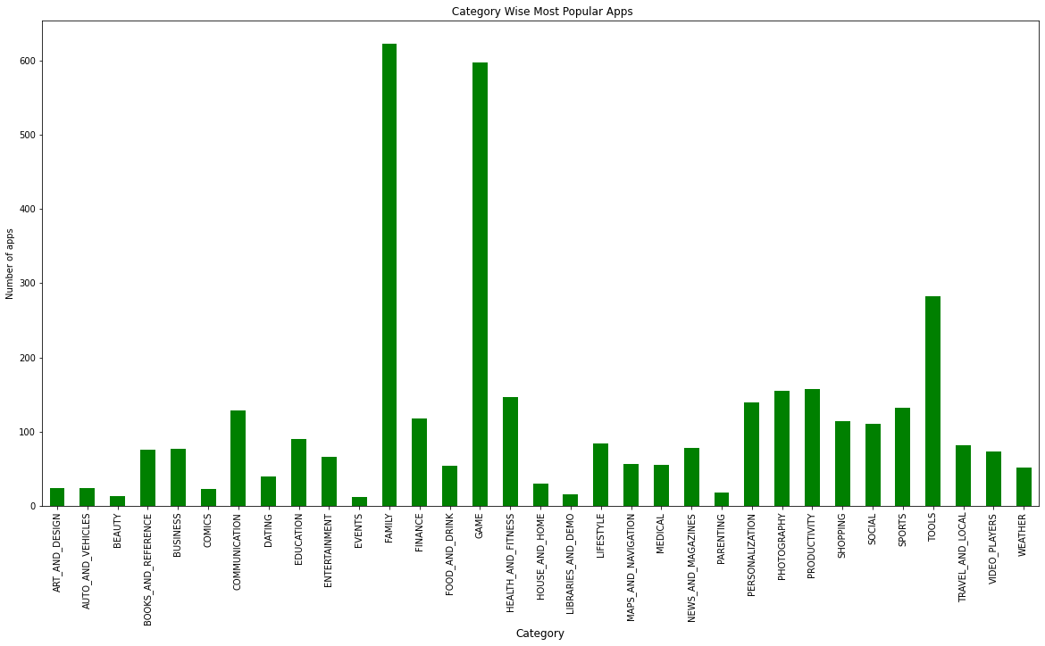
Category Wise Most Popular Apps

Slide 7
Category Wise Most Popular Apps
Findings : From the above bar Chart we filtered negligible count of Reviews (considered only which having more than 1000 reviews) and Ratings (Which rated more than 4). So that we can infer the most popular App Category.
1) Family, 2) Gaming
Recommendations:
i) Investors in app development might choose from the aforementioned categories for high marketing returns.
ii) Since they have become a need for every Android smartphone user, entrepreneurs and software solution providers may target these APP categories for marketing and contracting.

Slide 8
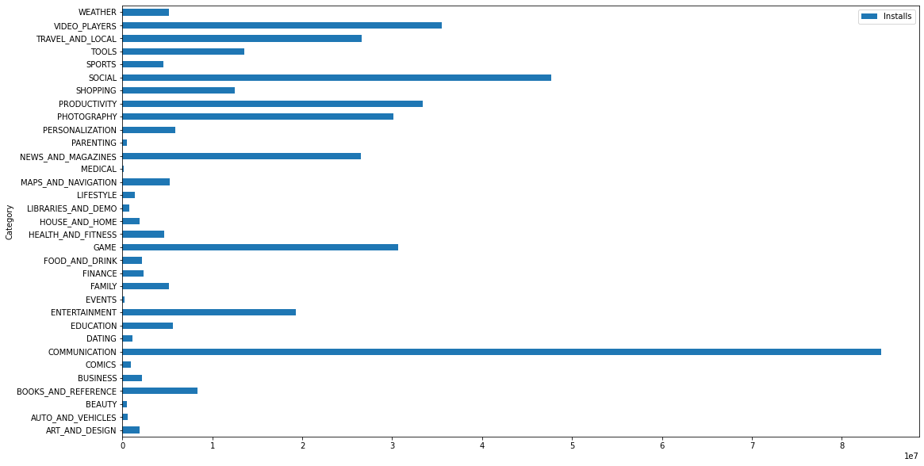
Barh Graph showing average installs ,Category Wise

Slide 9

Barh Graph showing average installs ,Category Wise
Findings & Recommendations
We recommend to develop an app in top 3 max installed categories of apps.
1) Communication or
2) Social or
3)Online Video Players
We find Parenting , Medicals ,Events, Auto & Vehicles category are least installed so we don’t recommend to develop such apps .

Slide 10
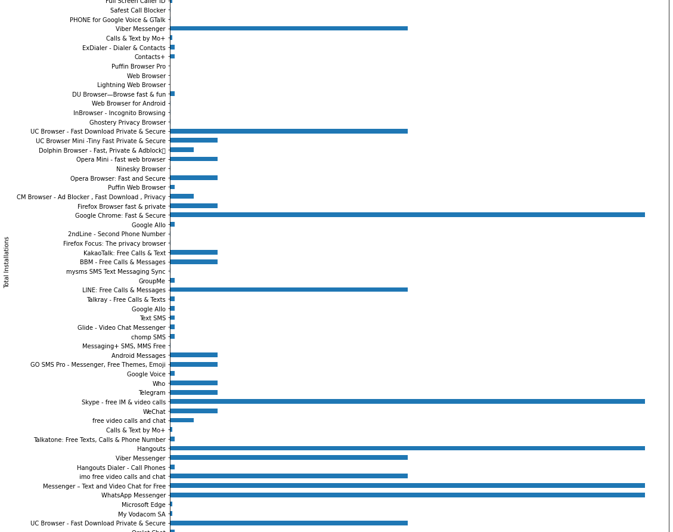
Most installed apps in Communication Category
Findings & Recommendations
We recommend to build app related to ..
Better free video calls experience
Apps which can make browsing experience better
Improved Mail experience

Slide 11
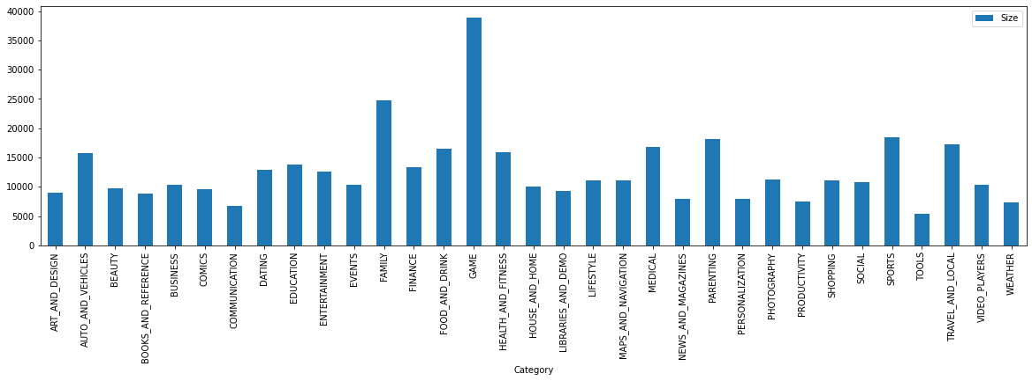
Showing Average sizes of apps in each category

Slide 12
Showing Average sizes of apps in each category
Findings & Recommendations
Our Study shows average sizes of all Highly installed categories of apps are below or around 12 MB, not very big in size .
We recommend to target your apps max size within 14 MB.

Slide 13
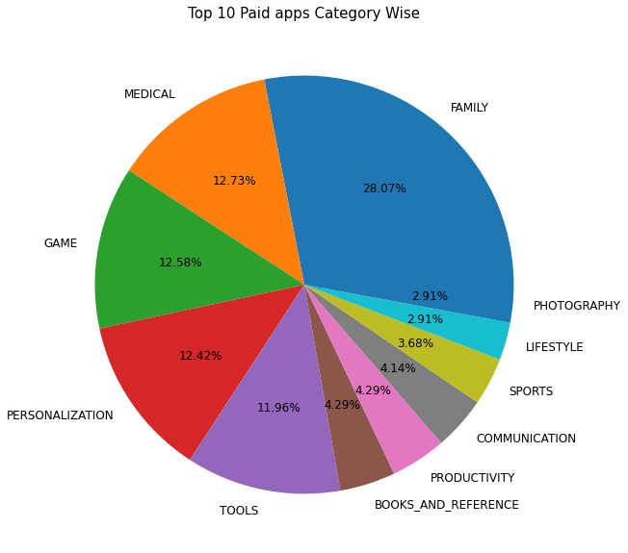
dh
Category wise percentage of paid apps
After filtering only paid apps from the data set, we can observe that more than 50% of the apps that are not free were concentrated in the Family,Medical and Game Category

Slide 14
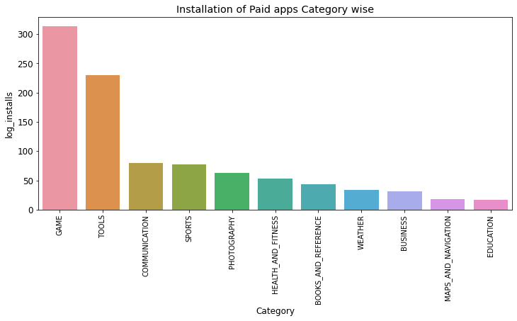
Category wise top installed Paid apps
In this graph we can observe that,most of the users had installed apps in the the Game and Tools category even though they were paid.So, app development business holders have scope to develop apps in these categories with the paid criteria.

Slide 15
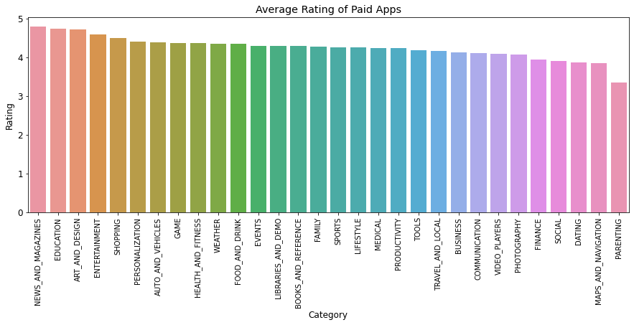
dh
Average Rating of Paid Apps
Again in the paid type, on an average News & Magazines,Education have high ratings. More concentration can be given to the lowest rating apps for further modifications and updations to get inserted into the market

Slide 16
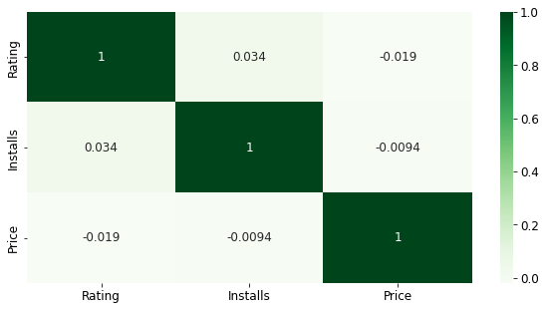
Correlation between Ratings,installs and Price
Here we can interpret that price and installation of apps are negatively correlated to each other which means for increase in the prices there are slight decrease of installations
And there is a slight positive correlation between Ratings and Installations

Slide 17
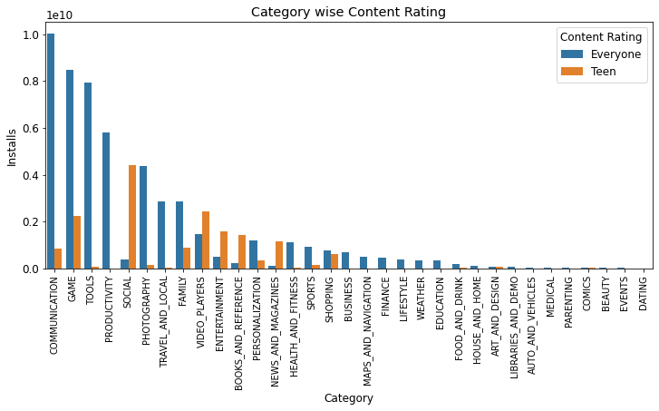
Category wise Installed Apps with Content Rating Everyone and Teens
Here we can observe that installed apps in the Social,Games category are high with the content rating Teens.

Slide 18
Content rating provides based on age variation.
Any developer put their applications on play store content which varies with users.
They put on basis of age categories system to show that what type of users are able to see this and avoid unappropriated harmness.
For eg. Whatsapp is simple message based service which not deliver any content so its suited for all categories while facebook has such news feed which not related 12-, children so it noted with 12+

Slide 19
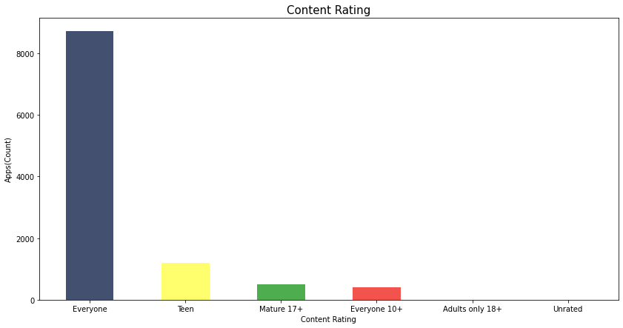
From here we can seen that maximum no of apps are targeted for everyone

Slide 20
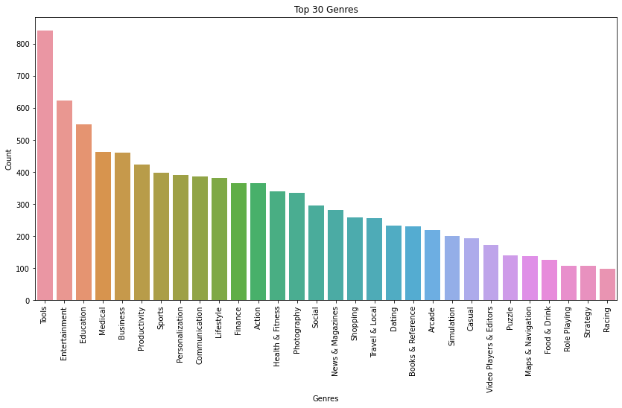
Top 30 Genres Here we can conclude from graph that tools genres have more number of downloads followed by entertainment

Slide 21
Users can choose categories which helps to search and discover most relevant apps in play store and tag to respected apps.
From Genres we know that trend of users for search and discover.
You should choose tags that are most obviously relevant to your app.

Slide 22
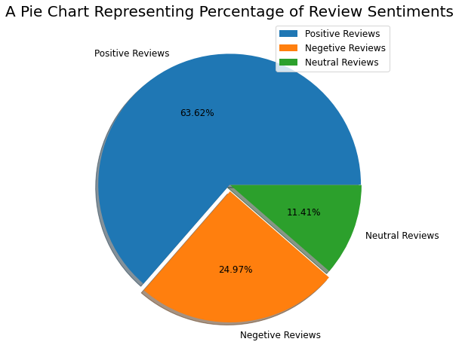
Percentage reviews sentiment distribution
From the below pie chart, it can easily be understood that there is around 65% of user reviews sentiment is positive, around 22% of reviews sentiment is negative and the remaining around 14% of reviews sentiment is neutral.

Slide 23
So, need to keep an eye-tracking on the review sentiment it is what decides whether the app is going to feature on google play store. By featuring I mean visibility of apps when someone searches for a category. If the app is not visible in the top 10 or 12 apps range then there are fewer chances of the app being installed.
If some apps have a higher percentage of positive reviews sentiments, then it is sure that the app is performing its intended work, and people are enjoying it, they may share the app with somebody thus increases the number of installations.

Slide 24
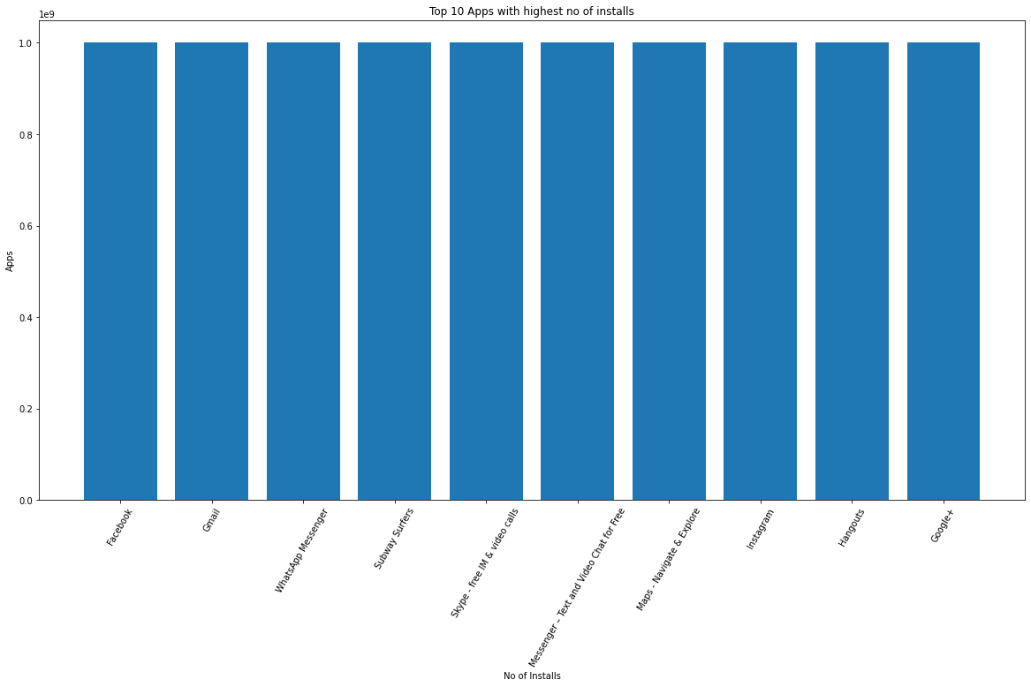
Top 10 best Apps in the Play Store considering all the parameters

Slide 25
Conclusions:
Based on the above EDA research, we can conclude that ,
App development business companies can be suggested to develop the applications with paid criteria in the categories like game, tools, communication. Developing in these can give them a better place in the market.
Average sizes of all 3 most installed categories of apps are well below 12 Mb size only .So,the app development company to target and limit the size of their app well below max 14 Mb .
Customers' essential needs, such as a few categories of apps, drive a large number of installations. These Apps stand in top 10 of the Google Play store 1) Facebook 2) Gmail 3) Whatsapp Messenger
Negative Correlation between Price and Installations & slightly positive correlation between Ratings and Installations
Number of installation according to content rating Everyone are in communication and gaming categories. Whereas Social category apps like Facebook, linkedin, instagram are more confined to teen category.
Regarding sentiment reviews,65% of them are positive, around 22% of user reviews are and the remaining 14% of the reviews are neutral.
App seems to be which is updating more versions have more number of users.

Slide 26
Since most of the apps are in communication category,it is recommended to build apps related to Better free video calls experience,Apps which can make browsing experience better ,Improved Mail experience
Customers' essential needs, such as a few categories of apps, drive a large number of installations. These Apps stand in top 10 of the Google Play store 1) Facebook 2) Gmail 3) Whatsapp Messenger

Slide 27
Q&A

